Slide 1

RESEARCH
PROJECT
Simulating Stochastic Processes
BY:
ABHISHEK L
ANVI GUPTA
7 JUNE 2025

Slide 2

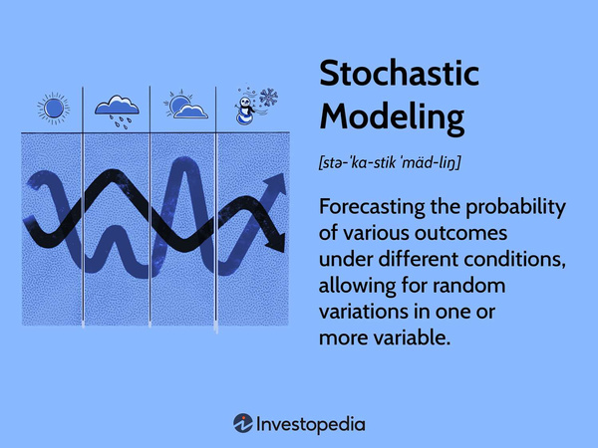
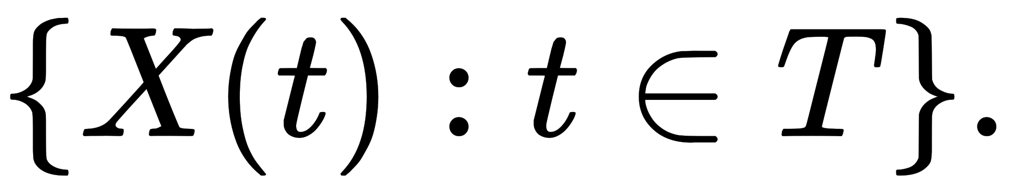
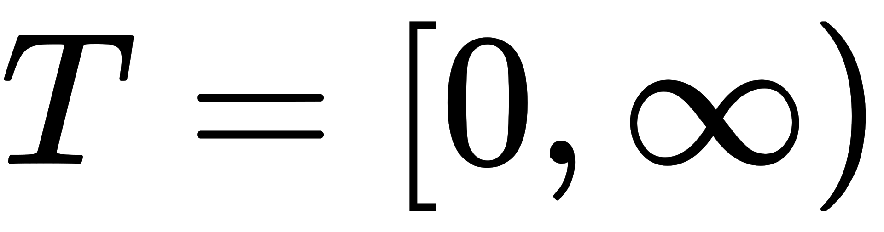

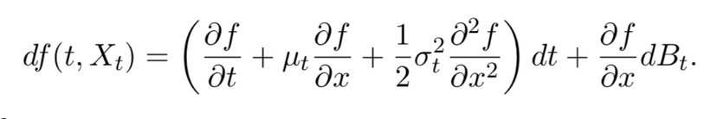
WHAT IS STOCHASTIC PROCESS ?
Stochastic process is a collection of random variable that moves across time ,defined on probability space (Ω,F,P)
Random Variable X=
Itô Calculus: A branch of stochastic calculus used to analyze and integrate with respect to Brownian motion.
Stochastic Differential Equation (SDE):An equation describing the dynamics of a stochastic process involving a noise term.Used to model various behaviours of stochastic models such as stock prices,random growth models
SDE = ODE + Gaussian White Noise
Itô Calculus: A branch of stochastic calculus used to analyze and integrate with respect to Brownian motion.
Ito’s lemma: Let f(t, x) be a smooth function of two variables, and let Xt be a stochastic process satisfying
dXt = µtdt + σtdBt for a Brownian motion Bt. Then
Ito’s lemma: Let f(t, x) be a smooth function of two variables, and let Xt be a stochastic process satisfying
dXt = µtdt + σtdBt for a Brownian motion Bt. Then
Gaussian White Noise: random process where each data point is independent & follows gaussian distribution
Gaussian White Noise: random process where each data point is independent & follows gaussian distribution

Slide 3
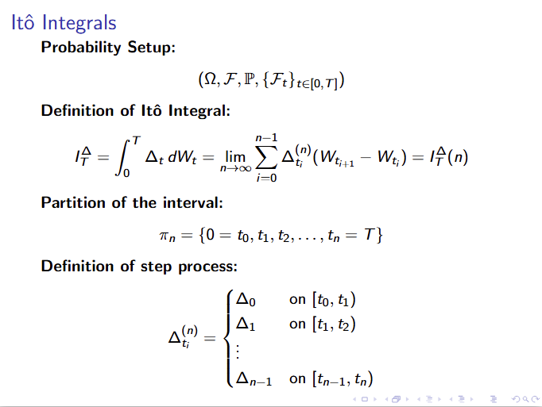

Slide 4
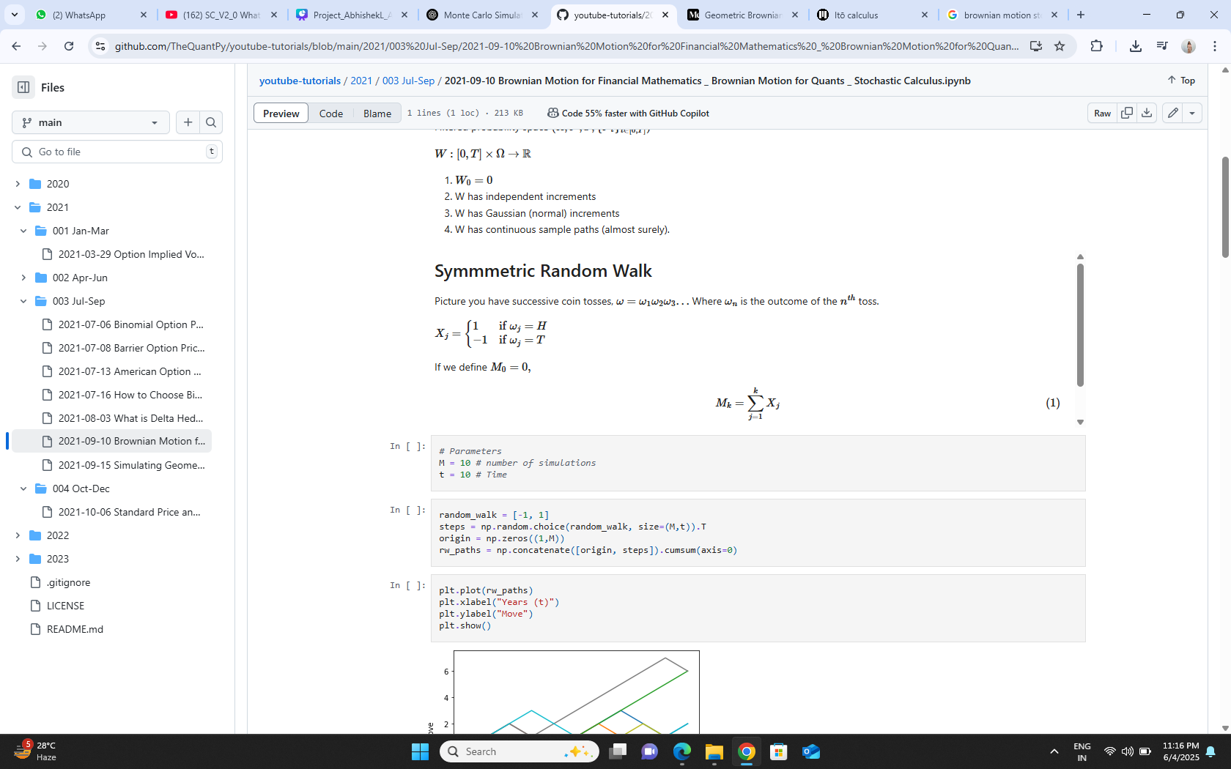
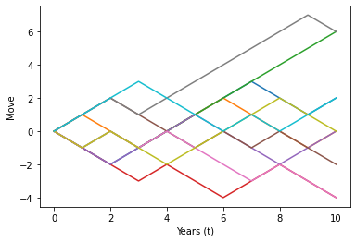
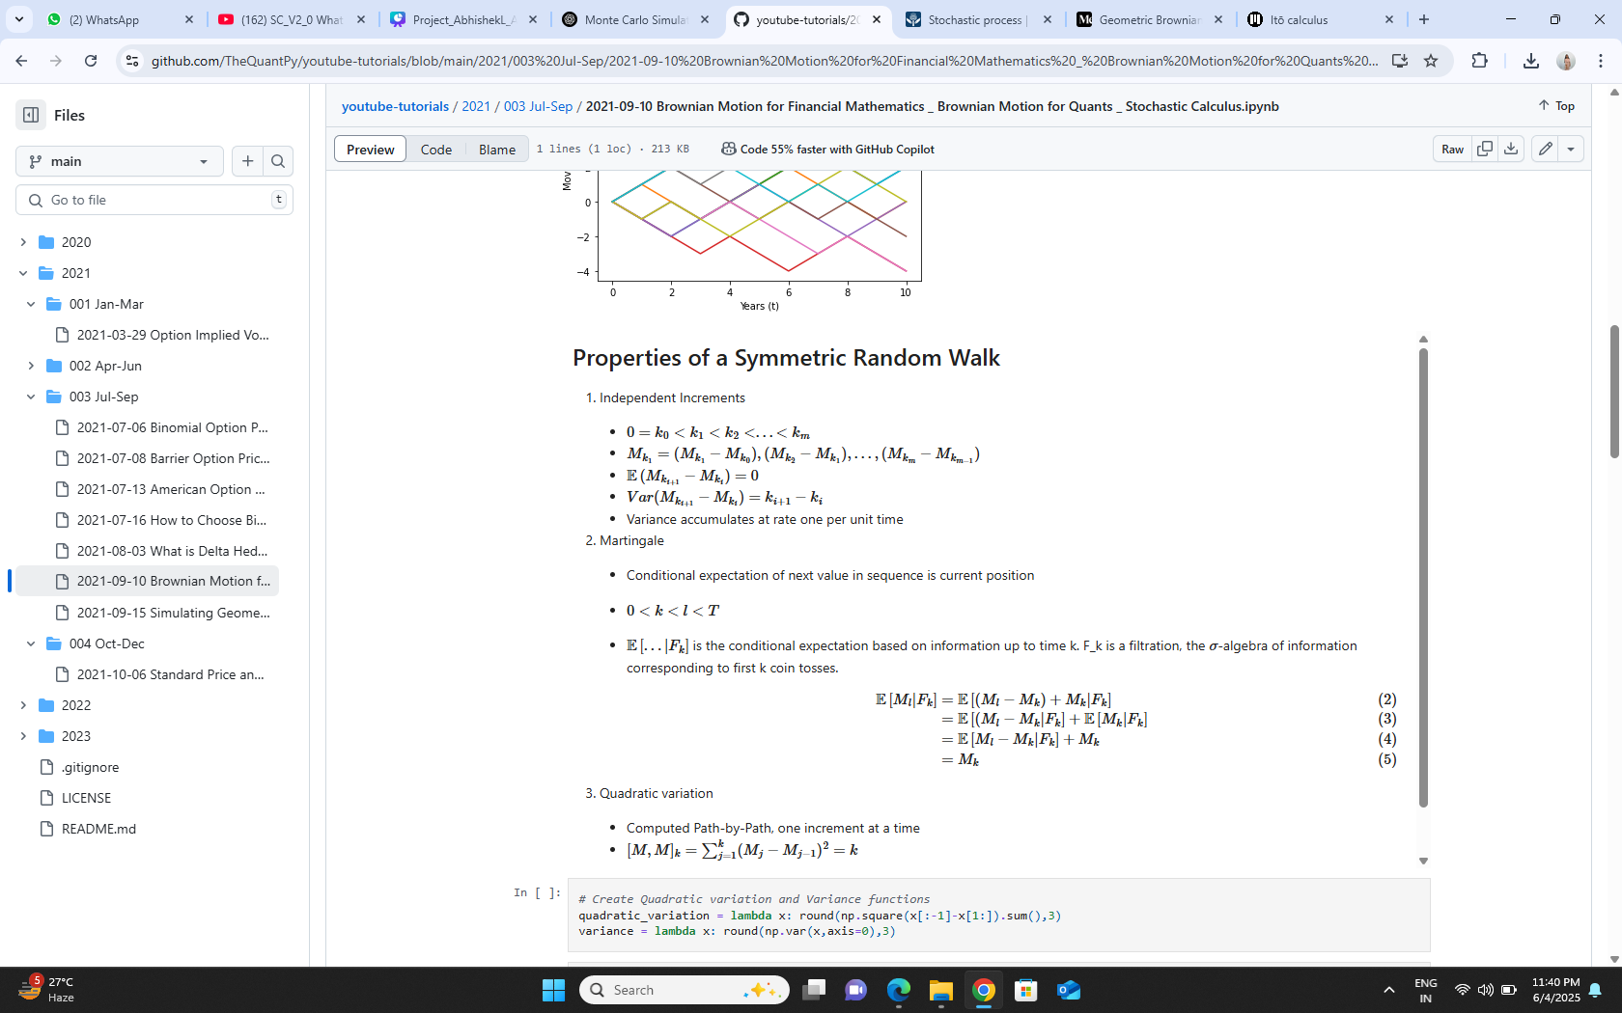
Random Walks
random walk, in probability theory, a process for determining the probable location of a point subject to random motions, given the probabilities (the same at each step) of moving some distance in some direction
if we define Mo=0,
The plot shows 10 simulated paths of a symmetric random walk over time
Each path starts at 0 and moves step-by-step either up (+1) or down (−1) with equal probability
Due to randomness, the paths diverge over time, forming a “fan-out” shape
This behavior reflects random fluctuations in systems like stock prices or noise in physical processes.
Many economists believe that stock market fluctuations, at least over the short run, are random walks.

Slide 5
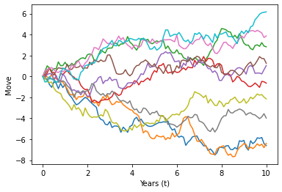
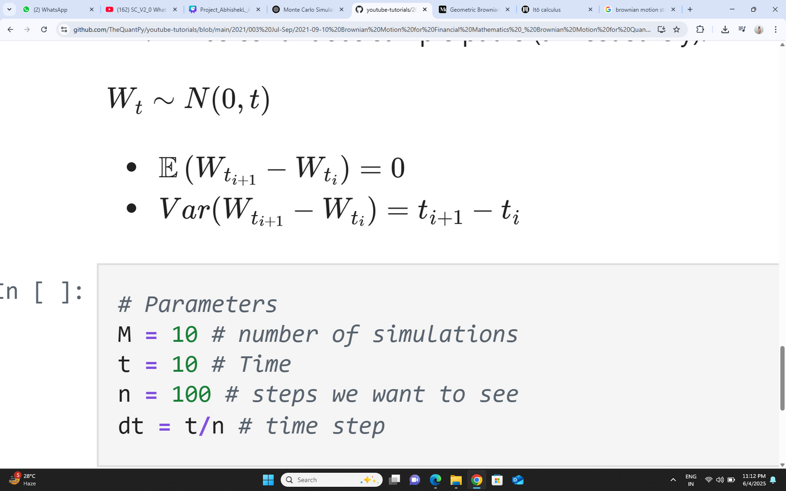
BROWNIAN MOTION
A Brownian motion is a stochastic process {Wt}t>0​,whose conditional likelihood is Gaussian with a variance that increases linearly in time interval that one considers and a zero mean,with the properties:
W0​=0
W has independent increments [Wt+s​−Ws​∼N(0,t)]
W has Gaussian (normal) increments [Wt​∼N(0,t)]
W has continuous sample paths (almost surely)

Slide 6
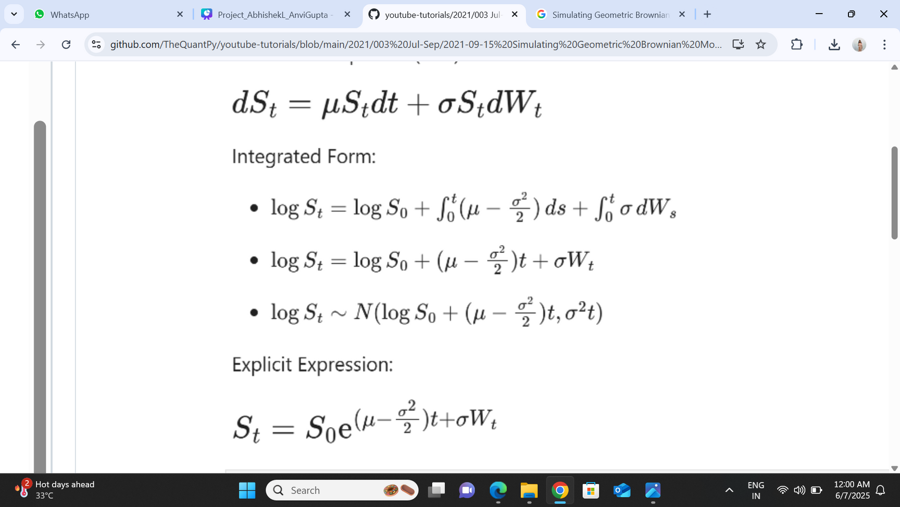
SIMULATING GEOMETRIC BROWNIAN MOTION
Simulating Geometric Brownian Motion (GBM) involves creating a stochastic process that models the movement of a quantity over time, where the logarithm of that quantity follows a Brownian motion with drift and volatility
where S(t) is the asset price at time t, μ is the drift, σ is the volatility, and dB(t) is the increment of a standard Brownian motion (Wiener process).(t),

Slide 7
Simulation Process:
Parameters: Define the initial asset price, drift, volatility, time horizon, number of time steps, and the number of simulations.
Time Steps: Divide the time horizon into small intervals (e.g., daily, monthly). .
Itô Calculus: A branch of stochastic calculus used to analyze and integrate with respect to Brownian motion.
Random Numbers: Generate random numbers from a standard normal distribution (mean of 0, standard deviation of 1).
Ito’s lemma: Let f(t, x) be a smooth function of two variables, and let Xt be a stochastic process satisfying
dXt = µtdt + σtdBt for a Brownian motion Bt. Then
Path Calculation: Calculate the asset price at each time step based on the SDE, using the drift, volatility, and the generated random numbers
Gaussian White Noise: random process where each data point is independent & follows gaussian distribution
Cumulative Product: Accumulate the changes over time to simulate the path of the asset price.

Slide 8
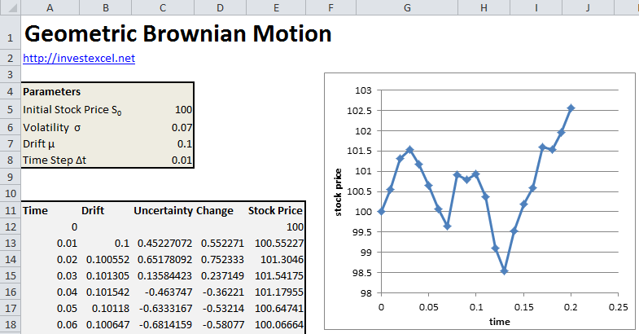

Slide 9

Brownian Motion
https://colab.research.google.com/drive/1r-_mbs7axs3pWt2Nju2fnwBzKPJY-xmi?authuser=1
Stimulation Geometric Brownian Motion
https://colab.research.google.com/drive/1NM5b7zBShk5jvF4zG818a7BXlKoIDpIo?authuser=1

Slide 10
THANK
YOU

